Slide 1

Description logic Inference procedure
Frank van Harmelen
Vrije Universiteit Amsterdam

Slide 2
Reasining in Description Logics
Slides from Szymon Klarman and Stefan Schlobach at Vrije Universiteit Amsterdam

Slide 3
Another example for A-box
Dan, Daisy and Dirk are a doctor
Pat, Paul and Dan are a patient
Daisy treats Pat
Pat is treated by Daisy
Dan suffers from pain and from sickness
Dan:doctor, Daisy:doctor, Dirk:doctor
Pat:patient, Paul:patient, Dan:patient
(Daisy,Pat):treats
(Pat,Daisy):treated_by
(Dan,pain):suffers_from, (Dan, sickness):suffers_from

Slide 4
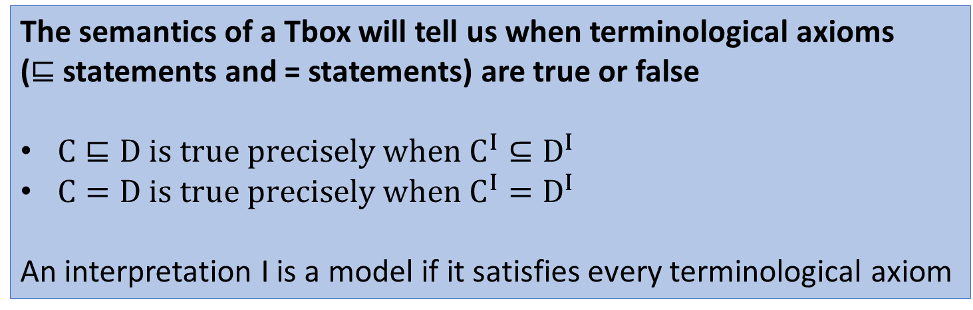
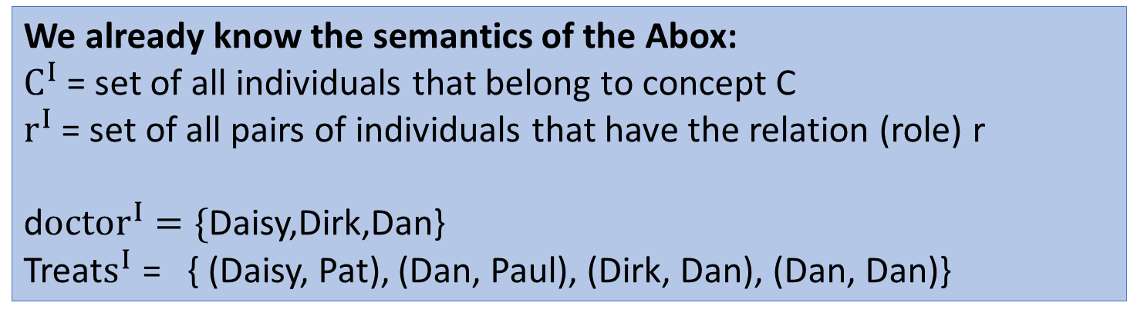
We already know the semantics of the Abox:
$C^{I}$= set of all individuals that belong to concept C
$r^{I}$ = set of all pairs of individuals that have the relation (role) r
d$octor^{I}=\{$Daisy,Dirk,Dan} Treat$s^{I}$ = { (Daisy, Pat), (Dan, Paul), (Dirk, Dan), (Dan, Dan)}
The semantics of a Tbox will tell us when terminological axioms
($⊑$ statements and = statements) are true or false
$C⊑D is true precisely when C^{I}⊆D^{I}$
$C=D is true precisely when C^{I}=D^{I}$
An interpretation I is a model if it satisfies every terminological axiom

Slide 5
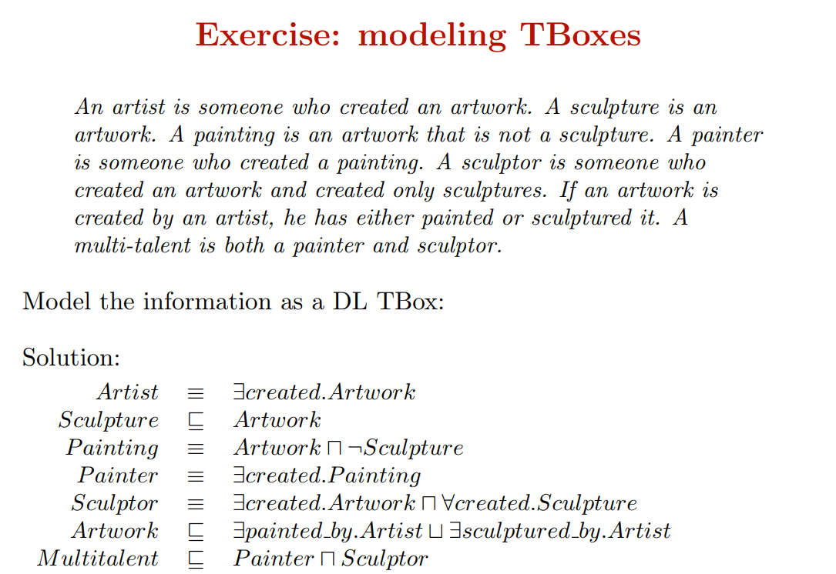

Slide 6
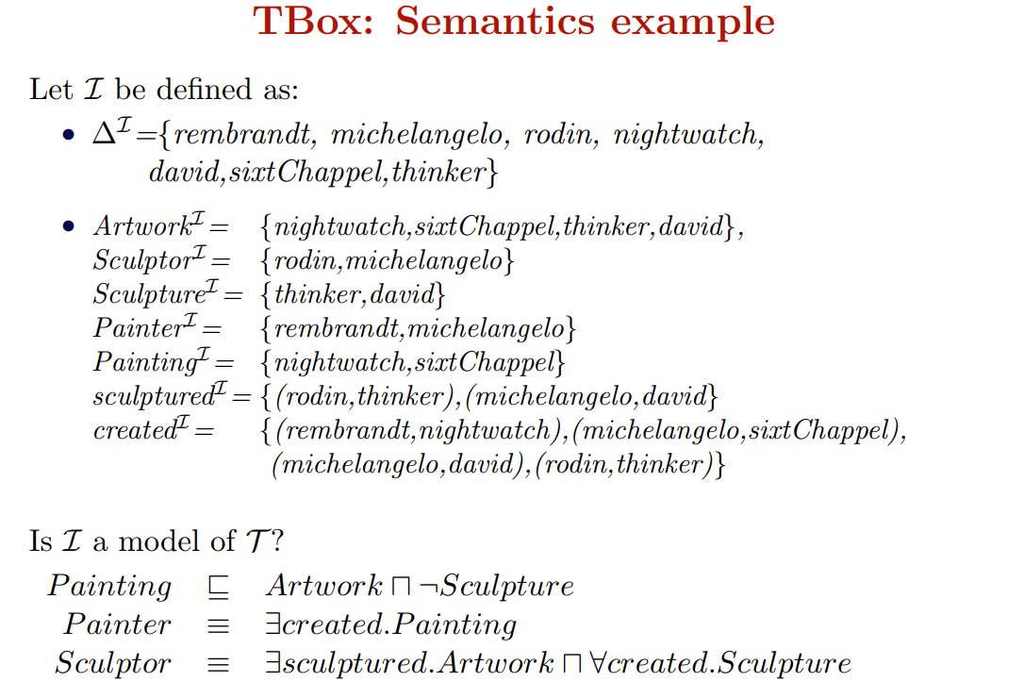

Slide 7
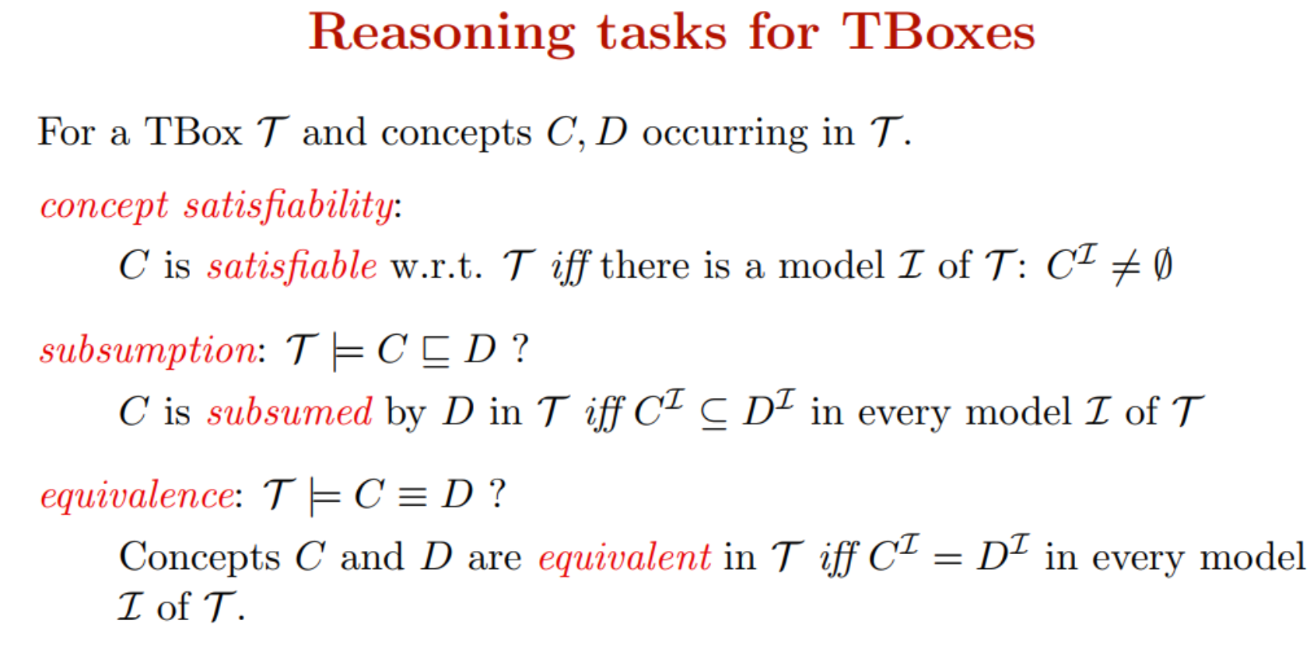

Slide 8
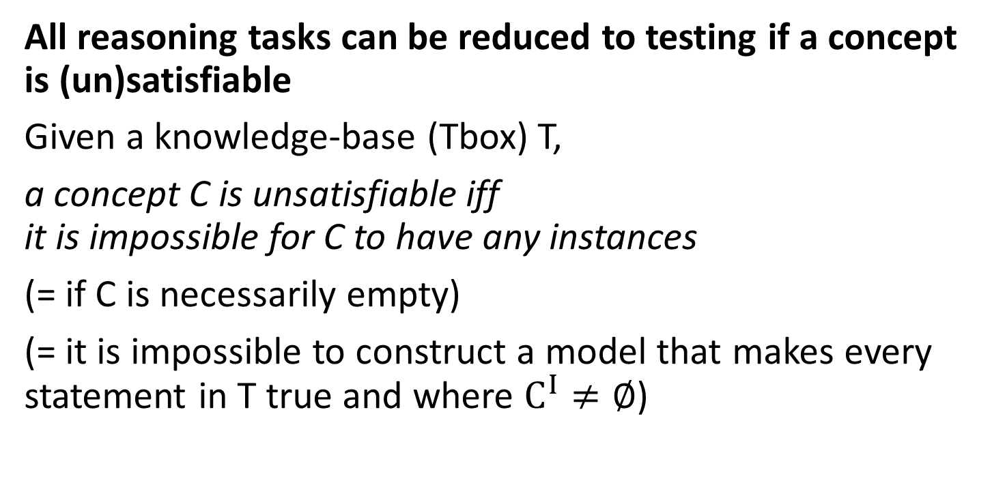
Reduction of T-box reasoning tasks
All reasoning tasks can be reduced to testing if a concept is (un)satisfiable
Given a knowledge-base (Tbox) T,
a concept C is unsatisfiable iff it is impossible for C to have any instances
(= if C is necessarily empty)
(= it is impossible to construct a model that makes every statement in T true and where $C^{I}≠∅$)

Slide 9


Reduction of T-box reasoning tasks
All reasoning tasks can be reduced to testing if a concept is (un)satisfiable:
(1) C $⊑D$ is equivalent to C$⊓¬D$ is unsatisfiable
(2) C = D is equivalent to C $⊑D$ and D $⊑C$
$$Δ$$
D
C

Slide 10
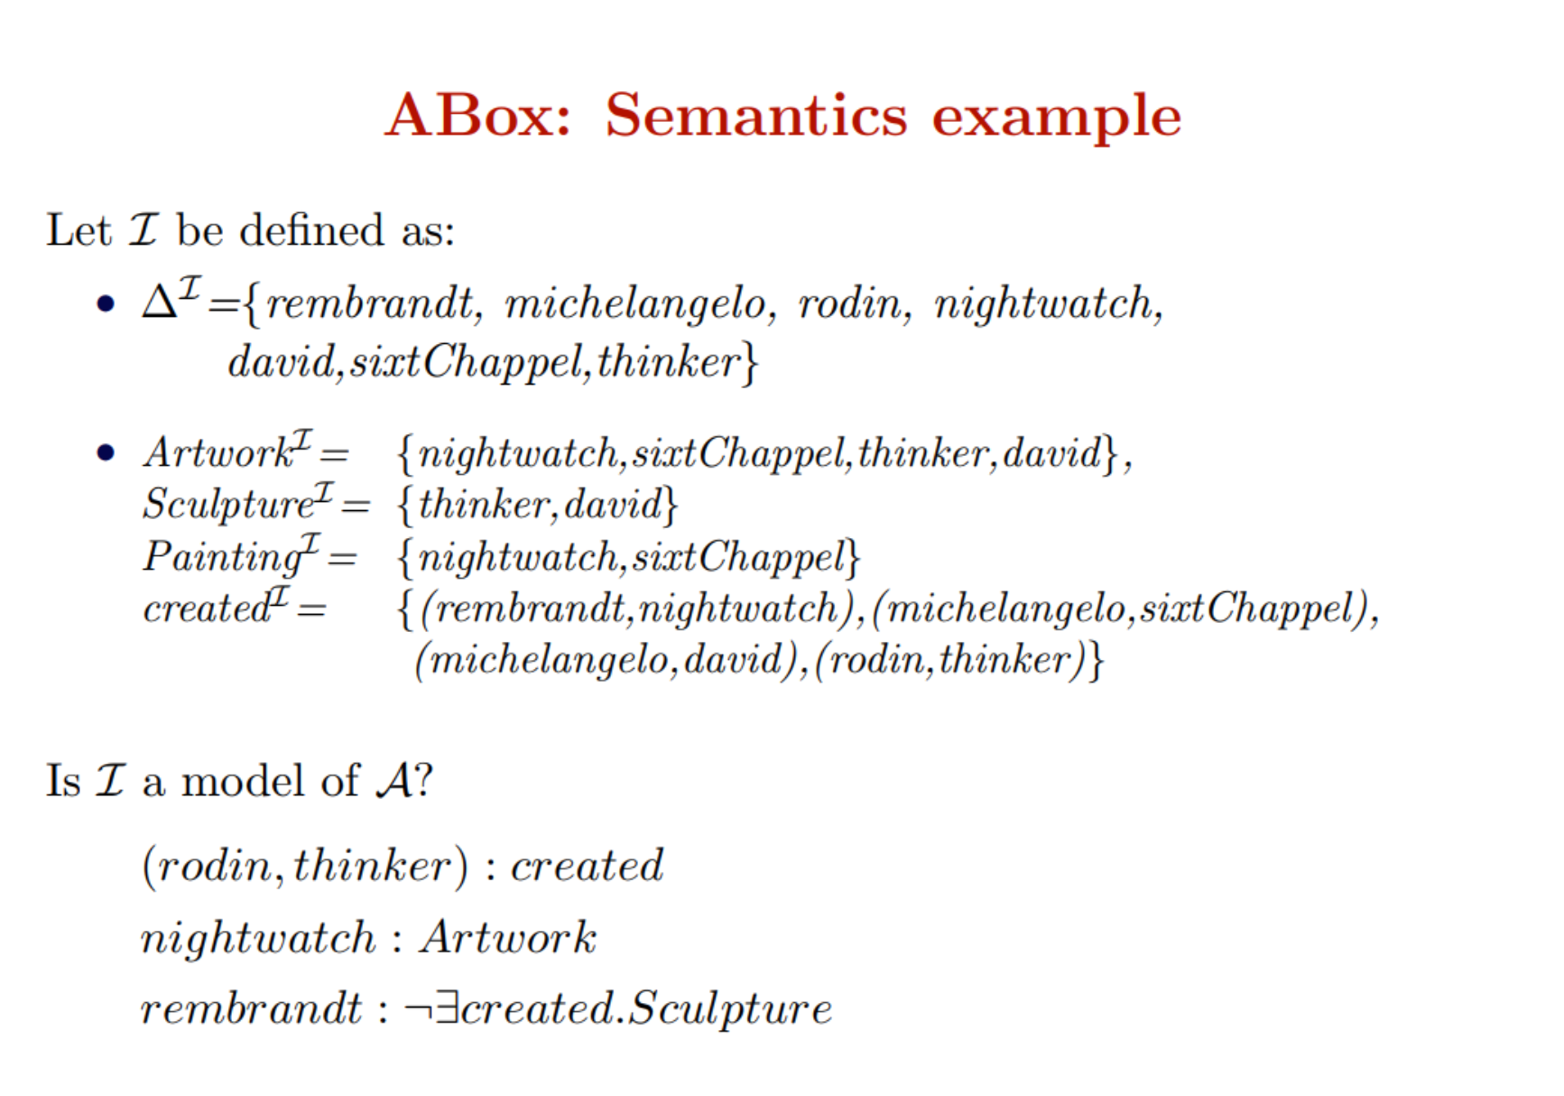

Slide 11
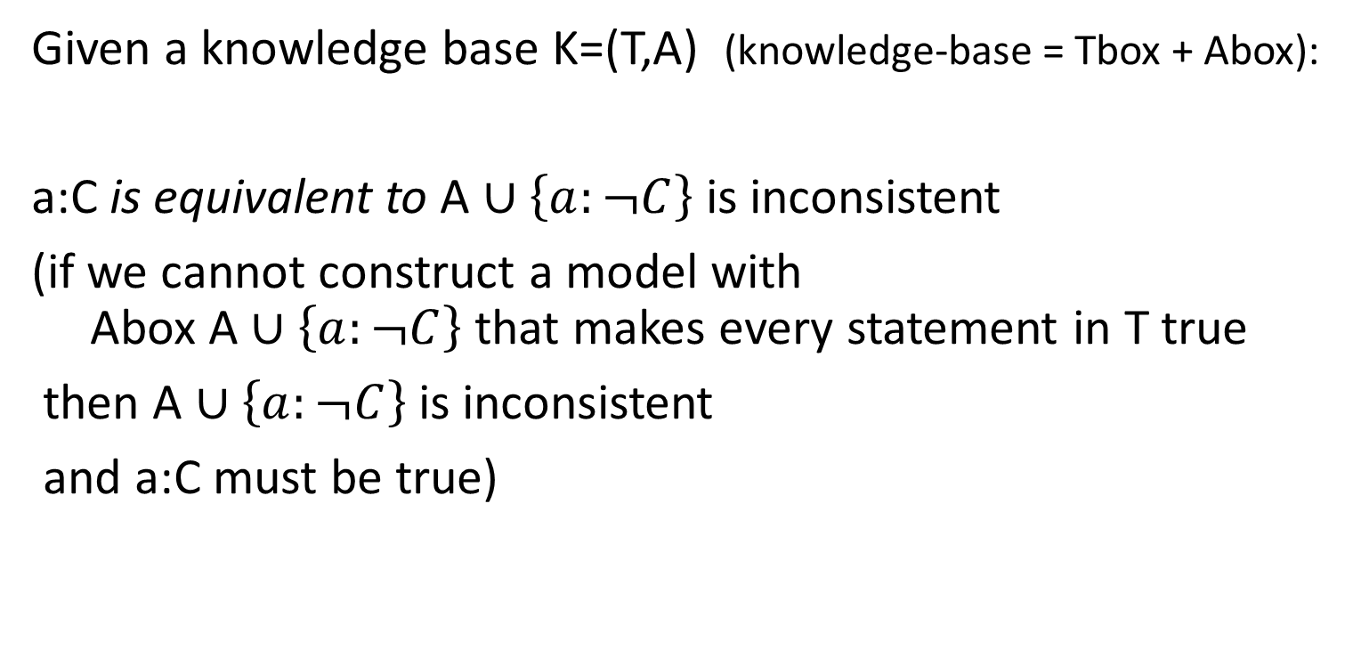
Reduction of A-box reasoning tasks
Given a knowledge base K=(T,A) (knowledge-base = Tbox + Abox):
a:C is equivalent to A $∪\left\{a:¬C\right\}$ is inconsistent
(if we cannot construct a model with Abox A $∪\left\{a:¬C\right\}$ that makes every statement in T true
then A $∪\left\{a:¬C\right\}$ is inconsistent
and a:C must be true)

Slide 12
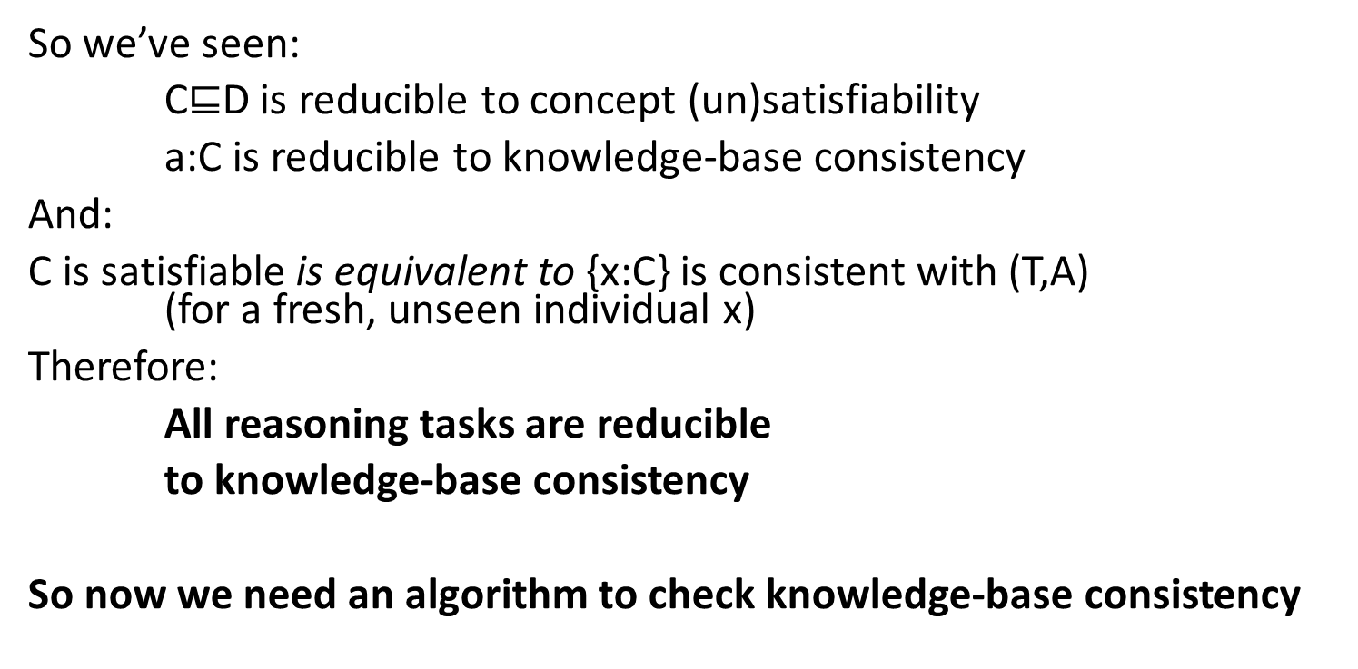
And finally…
So we’ve seen:
C$⊑$D is reducible to concept (un)satisfiability
a:C is reducible to knowledge-base consistency
And:
C is satisfiable is equivalent to {x:C} is consistent with (T,A) (for a fresh, unseen individual x)
Therefore:
All reasoning tasks are reducible
to knowledge-base consistency
So now we need an algorithm to check knowledge-base consistency

Slide 13
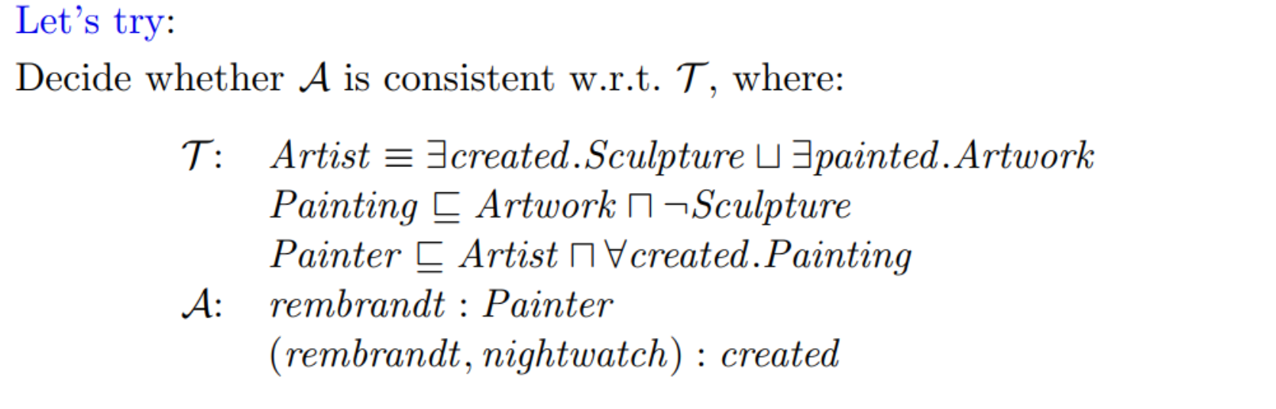
So now we need an algorithm to check knowledge-base consistency
Remember:
Knowledge-base consistency checking =
Knowledge-base model finding
(in)consistent means “there is a(no) model”
So now we need an algorithm to find a knowledge-base model

Slide 14
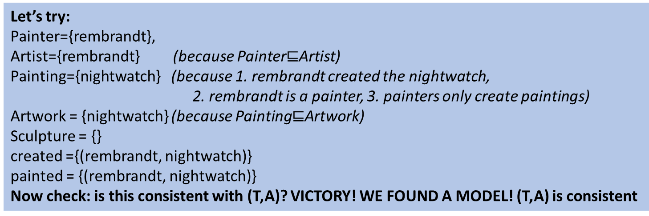
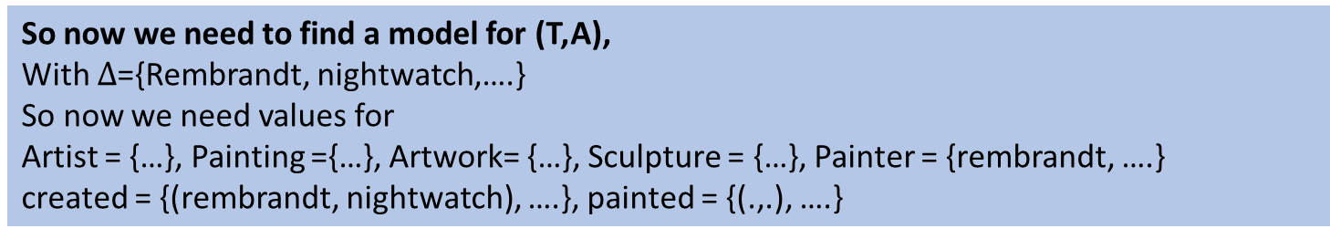
So now we need to find a model for (T,A),
With $Δ$={Rembrandt, nightwatch,….}
So now we need values for
Artist = {…}, Painting ={…}, Artwork= {…}, Sculpture = {…}, Painter = {rembrandt, ….}
created = {(rembrandt, nightwatch), ….}, painted = {(.,.), ….}
Let’s try:
Painter={rembrandt},
Artist={rembrandt} (because Painter$⊑$Artist)
Painting={nightwatch} (because 1. rembrandt created the nightwatch,
2. rembrandt is a painter, 3. painters only create paintings)
Artwork = {nightwatch} (because Painting$⊑$Artwork)
Sculpture = {}
created ={(rembrandt, nightwatch)}
painted = {(rembrandt, nightwatch)}
Now check: is this consistent with (T,A)? VICTORY! WE FOUND A MODEL! (T,A) is consistent

Slide 15
Pffff, that was difficult….
We don’t want to do that by hand…
…. Every time…
…. For very large knowledge bases…
(remember: the Tbox of Snomed has 300.000 axioms!
(our example just had 3 axioms….)
So now we need an algorithm to find a knowledge-base model

Slide 16
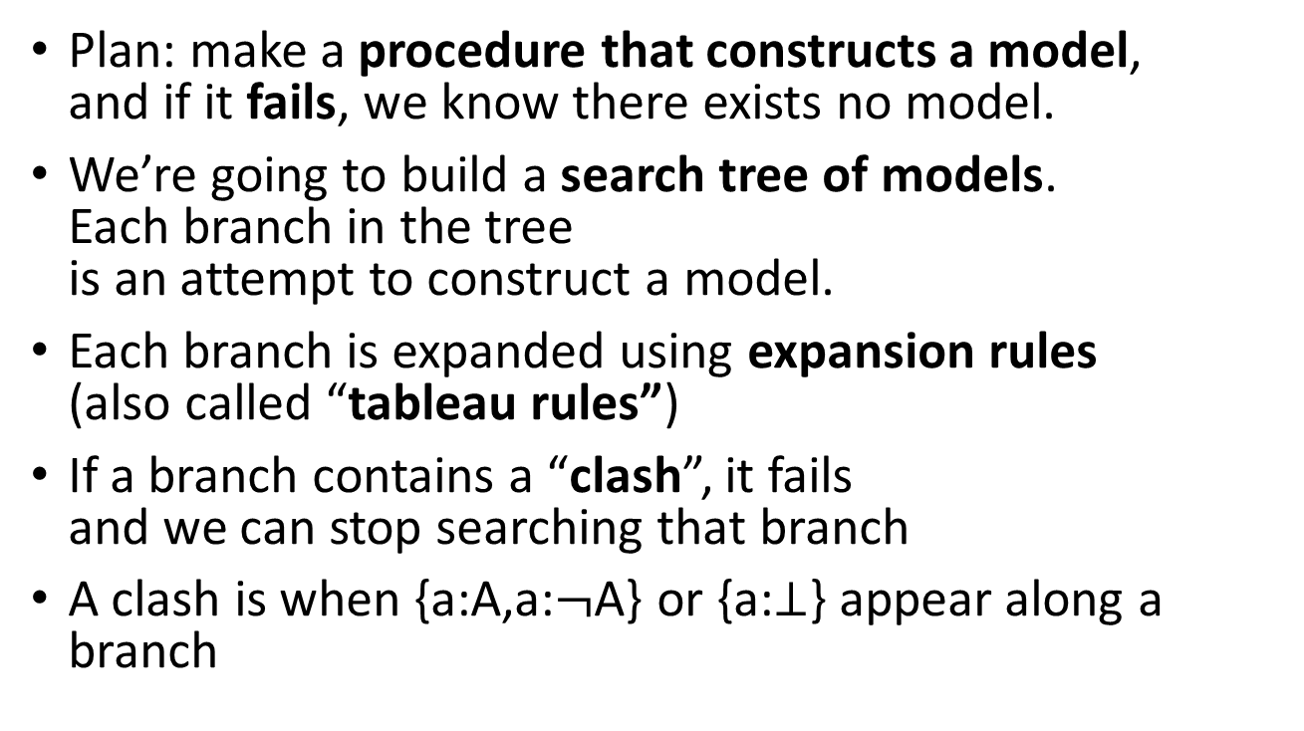
Tableau algorithm
So now we need an algorithm to find a knowledge-base model
Plan: make a procedure that constructs a model, and if it fails, we know there exists no model.
We’re going to build a search tree of models. Each branch in the tree is an attempt to construct a model.
Each branch is expanded using expansion rules (also called “tableau rules”)
If a branch contains a “clash”, it fails and we can stop searching that branch
A clash is when {a:A,a:$¬$A} or {a:$⊥$} appear along a branch

Slide 17
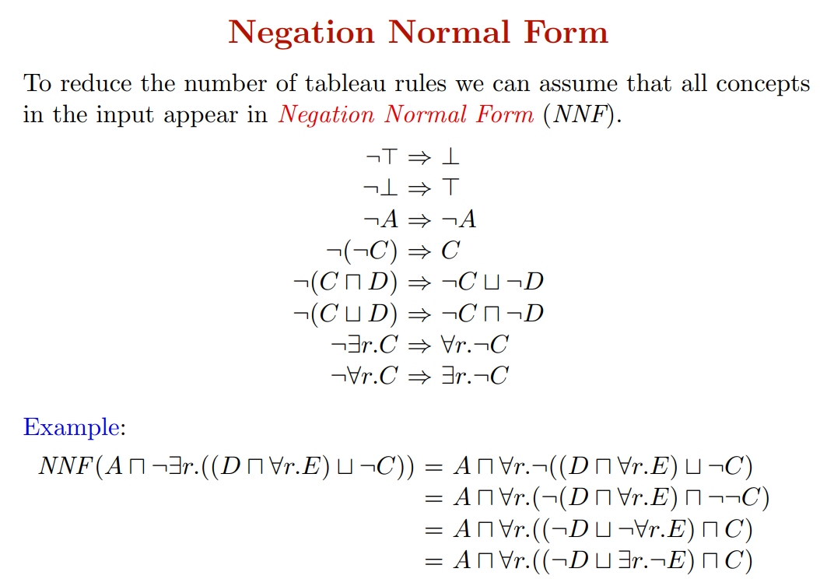

Slide 18
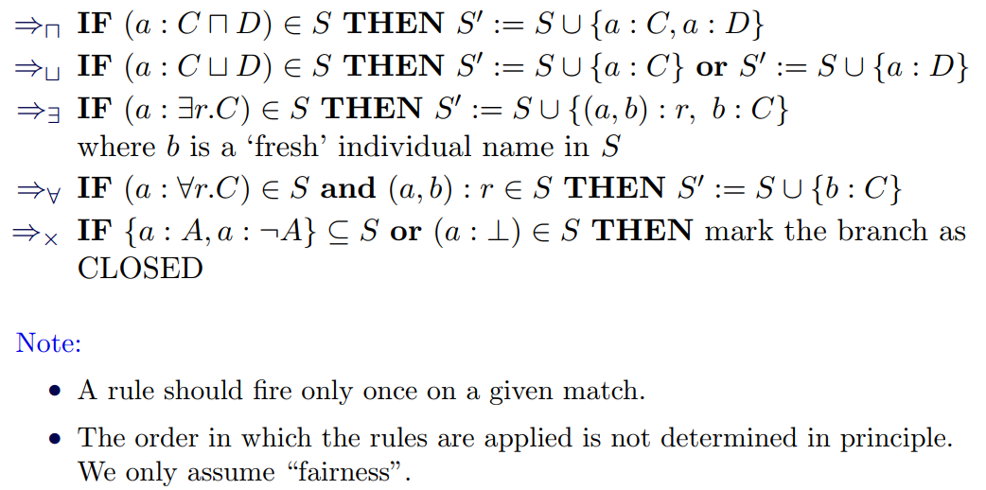
Tableau rules
Every node has a set of Abox statements S,
Each rule expands S to S’ by adding some Abox statements.
This way, we are gradually trying to build a model

Slide 19
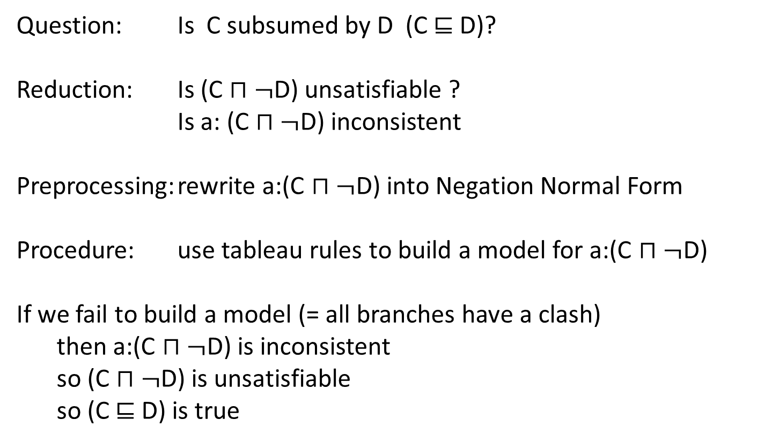
Procedure
Question: Is C subsumed by D (C $⊑$ D)?
Reduction: Is (C $⊓¬$D) unsatisfiable ?
Is a: (C $⊓¬$D) inconsistent
Preprocessing: rewrite a:(C $⊓¬$D) into Negation Normal Form
Procedure: use tableau rules to build a model for a:(C $⊓¬$D)
If we fail to build a model (= all branches have a clash)
then a:(C $⊓¬$D) is inconsistent
so (C $⊓¬$D) is unsatisfiable
so (C $⊑$ D) is true
Notice: if we fail to build a model,
The answer to the original question is yes”!!

Slide 20
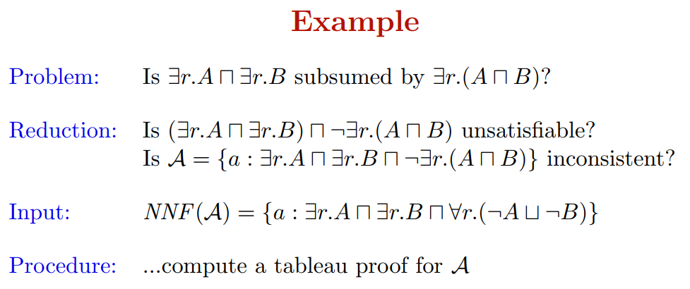
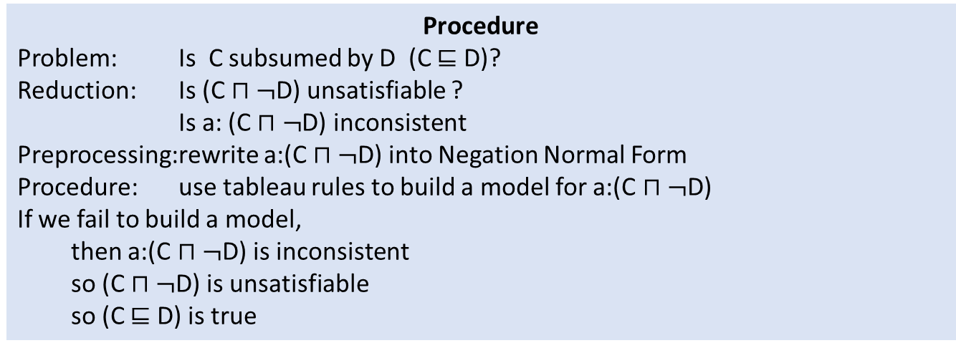
Procedure
Problem: Is C subsumed by D (C $⊑$ D)?
Reduction: Is (C $⊓¬$D) unsatisfiable ?
Is a: (C $⊓¬$D) inconsistent
Preprocessing: rewrite a:(C $⊓¬$D) into Negation Normal Form
Procedure: use tableau rules to build a model for a:(C $⊓¬$D)
If we fail to build a model,
then a:(C $⊓¬$D) is inconsistent
so (C $⊓¬$D) is unsatisfiable
so (C $⊑$ D) is true

Slide 21
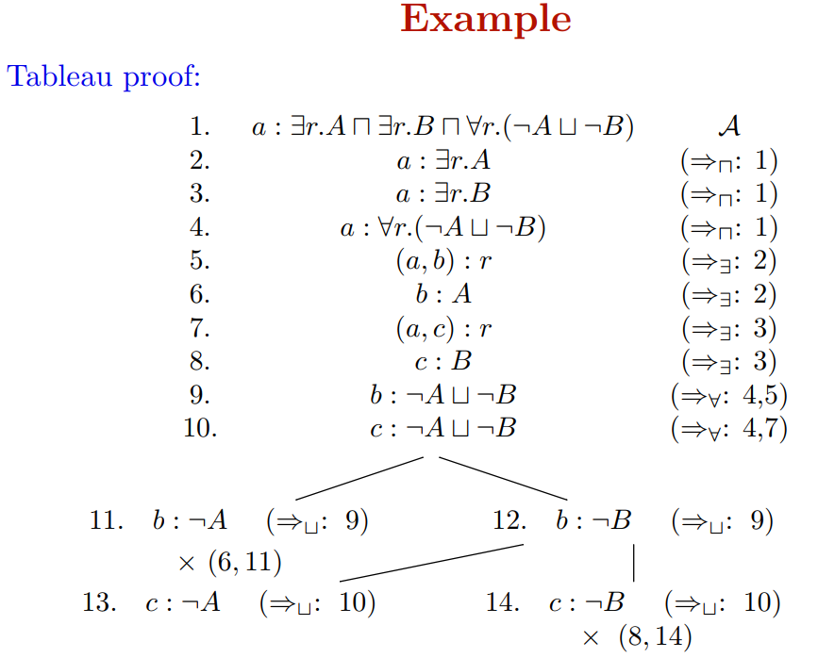

Slide 22
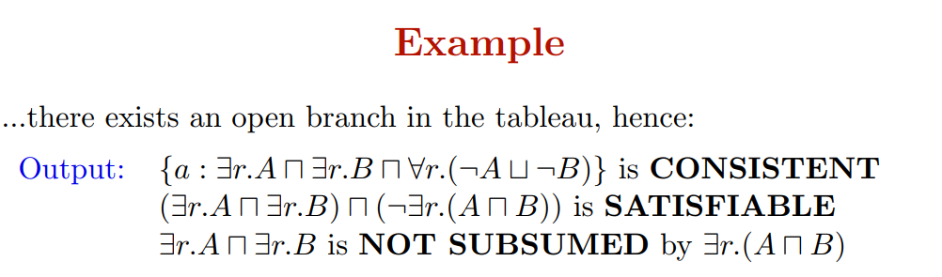
Can we be sure that there exists a model?
Yes! We can even read off the model from the open branch:
Simply follow the entire open branch from top to bottom,
and collect all atomic Abox statements:

Slide 24
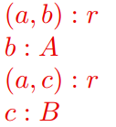

And indeed:
is a model of

Slide 25
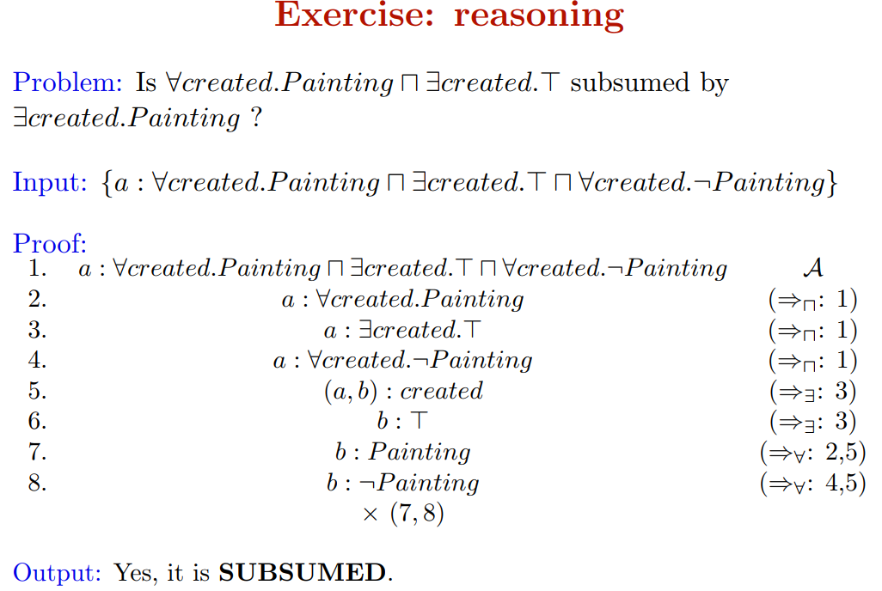
$(∀$created.Painting $⊓∃$created.T) $⊑∃$created.Painting ?

Slide 26
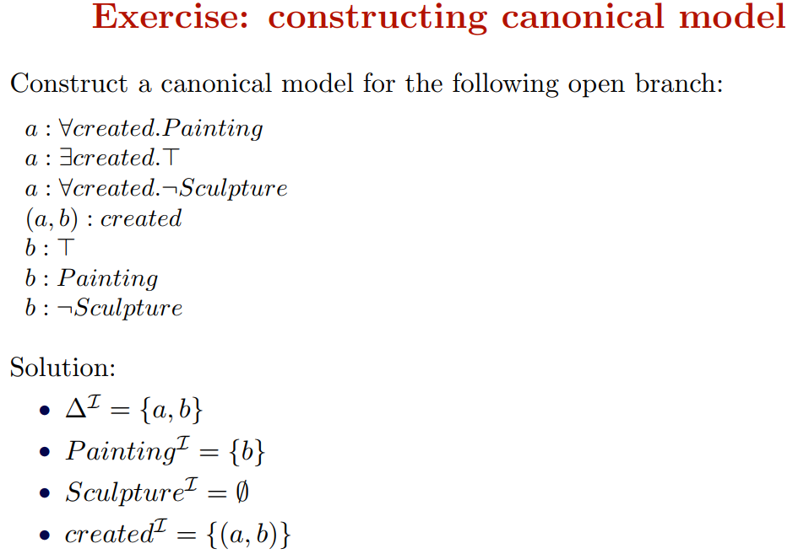

Slide 27
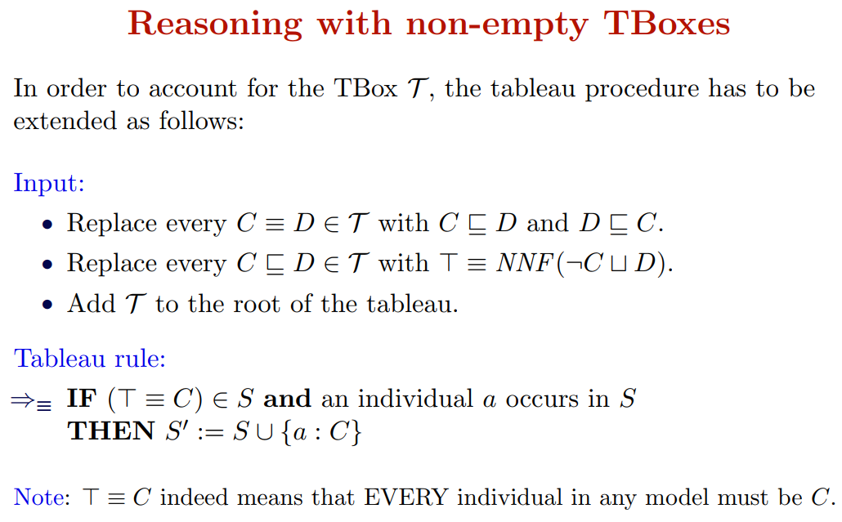

Slide 28
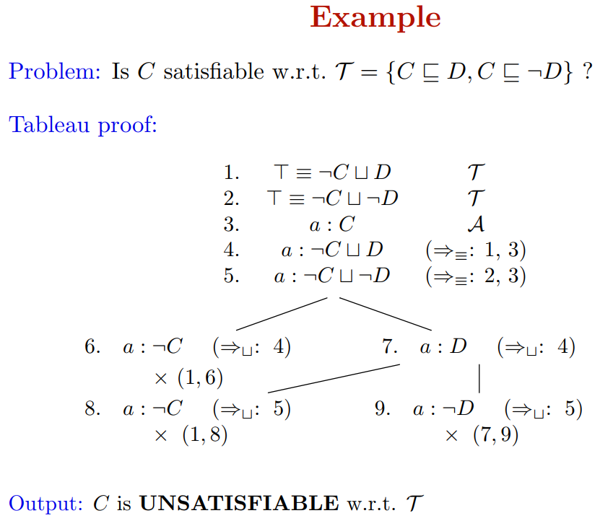

Slide 29
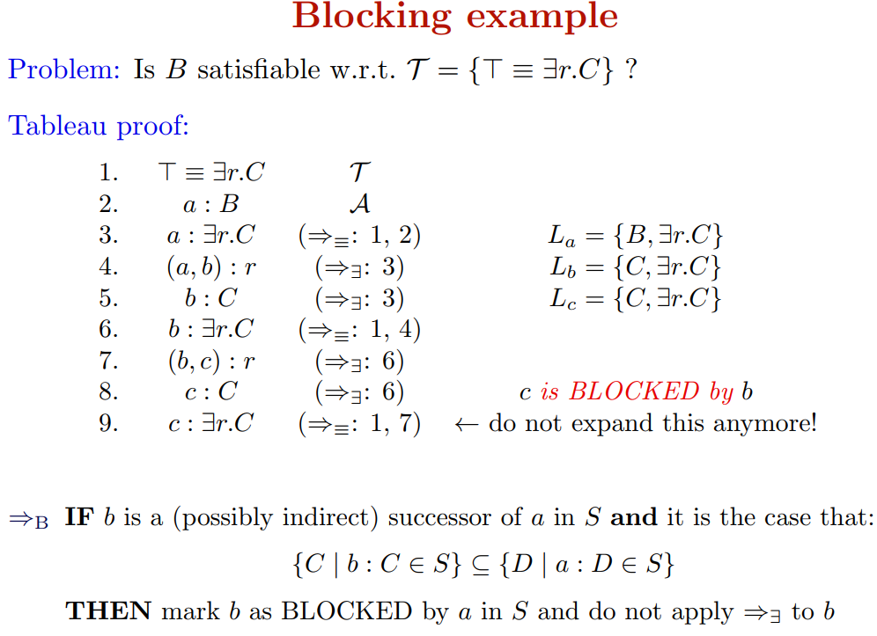
Only apply blocking if no other rules (apart from $∃$ applies !

Slide 30
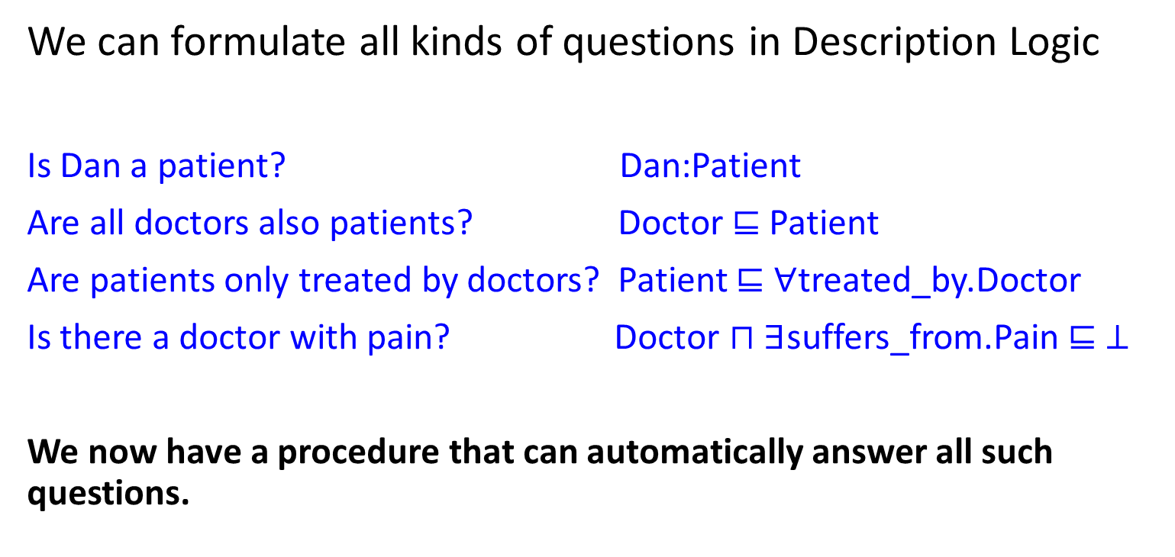
Summary
We can formulate all kinds of questions in Description Logic
Is Dan a patient? Dan:Patient
Are all doctors also patients? Doctor $⊑$ Patient
Are patients only treated by doctors? Patient $⊑$ $∀$treated_by.Doctor
Is there a doctor with pain? Doctor $⊓∃$suffers_from.Pain $⊑ ⊥$
We now have a procedure that can automatically answer all such questions.

